Slide 1

ARTIFICIAL INTELLIGENCE
SPRINT-3

Slide 2
MACHINE LEARNING FOR MEDICAL DIAGNOSIS-BREAST CANCER
Sahana Nalla
00658650

Slide 3
Using Machine Learning to Detect and Diagnose Breast Cancer
One application of machine learning in a healthcare context is digital diagnosis. ML can detect patterns of certain diseases within patient electronic healthcare records and inform clinicians of any anomalies
In this sense, the artificial intelligence technique can be compared to a second pair of eyes that can evaluate patient health based on the knowledge extracted from big data sets by summarizing millions of observations of diseases that a patient could possibly have

Slide 4
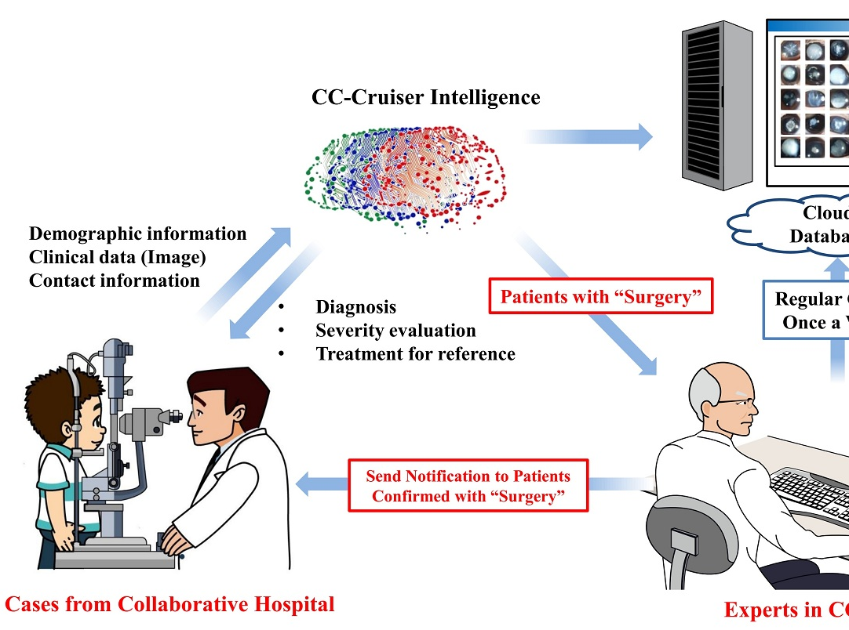
Growth drivers of AI in healthcare
Increasing individual healthcare expenses
Larger Geriatric population
Imbalance between health workforce and patients
Increasing Global Health care expenditure
Continuous shortage of nursing and technician staff. The number of vacancies for nurses will be 1.2 million by 2020
AI is and will help medical practitioners efficiently achieve their tasks with minimal human intervention, a critical factor in meeting increasing patient demand.

Slide 5
Instances attributed from the Data Set
The breast cancer data set consists of 699 tumor samples where 458 (65.5%) are benign (non-cancer) tumors and 241 (34.5%) malignant (cancer) tumors.

Slide 6
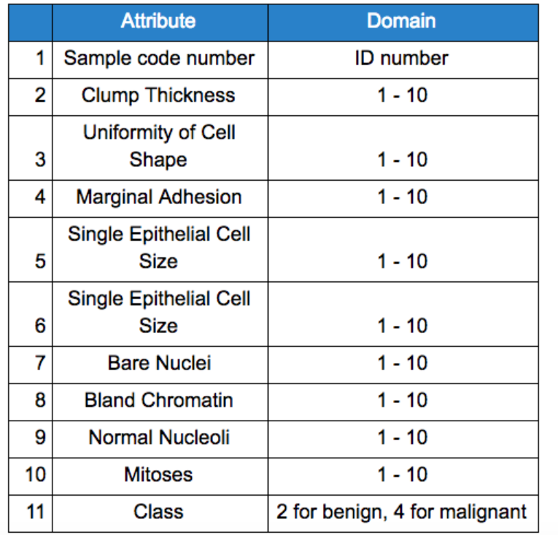
Attributes in the Data Set

Slide 7
Setting up the Diagnosis Model
This procedure involves 7 steps which includes formulas and graphs for better understanding

Slide 8
Step 1: Dividing the Data Set
In order to get started modeling, the data set was split into two parts:
Train set (70%), for choosing and validating models, and
Test set (30%), hold out data on which we will see how well models are able to generalize on unseen data.

Slide 9
Step 2: Defining the Metrics
Next, we need to define the key metrics to measure the efficiency of the models. We have four basic characteristics (numbers) based on which we can define derivative measurement metrics. These four numbers are:
TP (True Positive) – number of correctly classified patients who have the disease,
TN (True Negative) – number of correctly classified patients who are healthy,
FP (False Positive) – number of misclassified patients who are healthy,
FN (False Negative) – number of misclassified patients who have the disease.

Slide 10
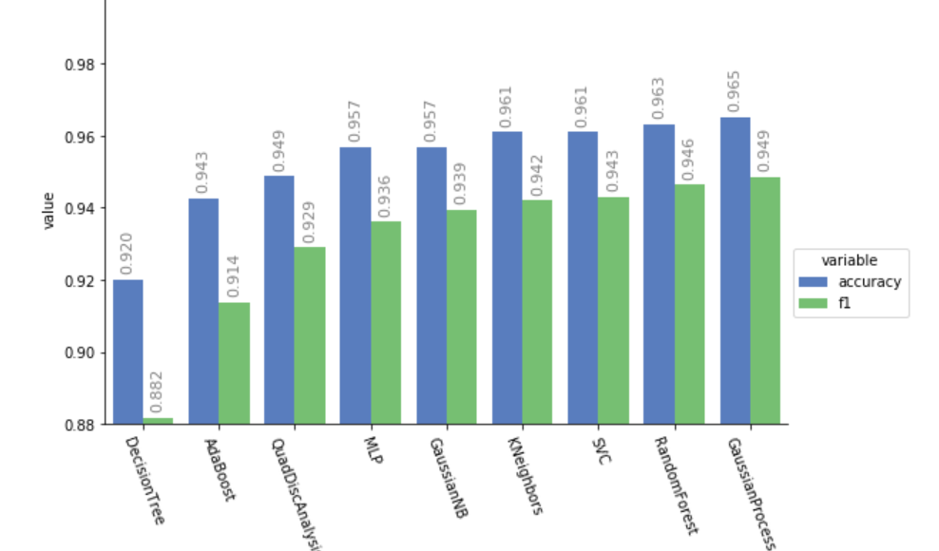
Step 3: Evaluating the Models
This step involves using precision and recall metrics to evaluate the models. For the sake of simplifying the comparison of various models, we will use the harmonic mean of precision and recall which is called an F1 score (F1 Score = 2*(Recall * Precision) / (Recall + Precision))

Slide 11
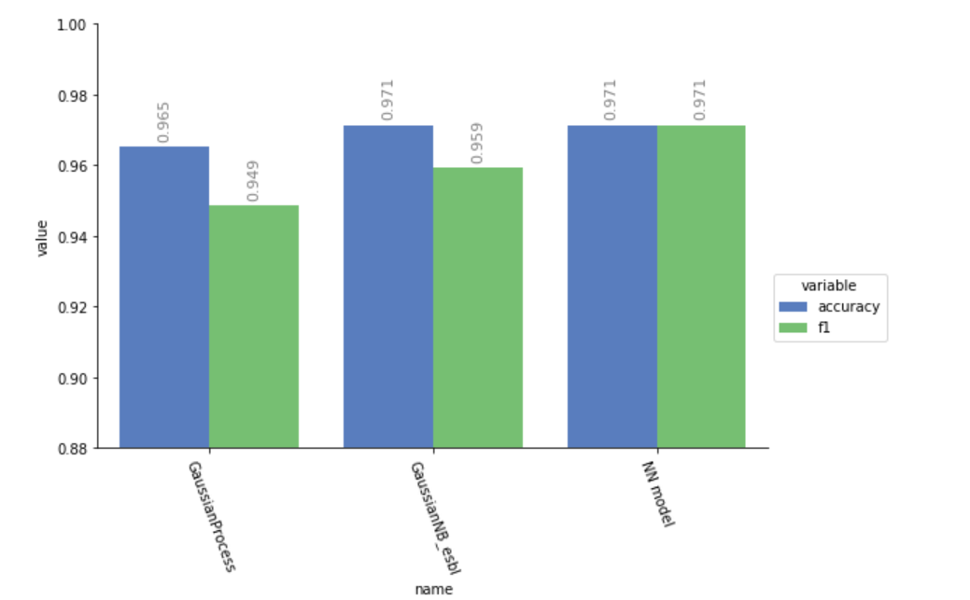
Step 4: Creating a Neural Network Model
In addition to the aforementioned diagnostic models, a Neural Network model was created and tuned using the architecture shown below.

Slide 12
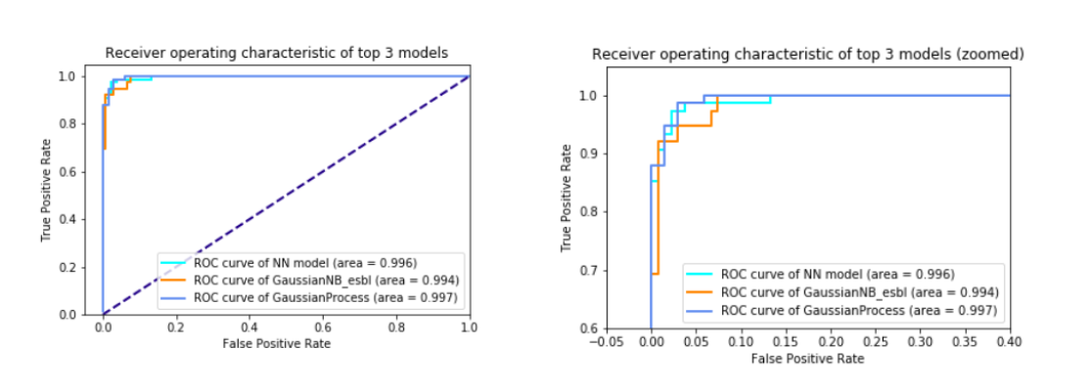
Step 5: Evaluating Output Quality Through Receiver Operating Curves
In order to further evaluate classifiers’ output quality, let’s view their receiver operating characteristic (ROC) curves

Slide 13
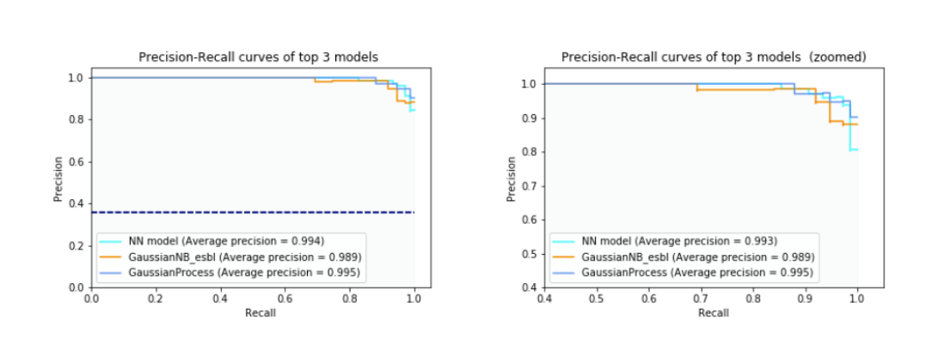
Step 6: Evaluating Output Quality Through Precision-Recall Curves
Let’s also look at the precision-recall curves associated with these classifiers.

Slide 14
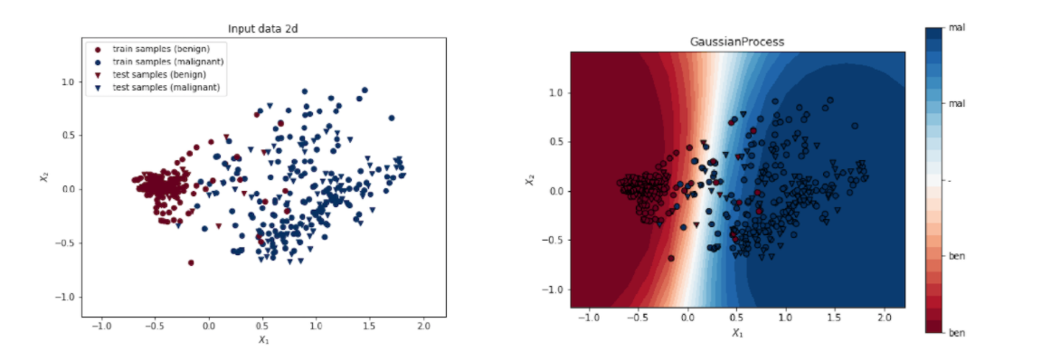
Step 7: Visualizing the Decision Boundaries
In order to gain some visual intuition about the data set and the algorithms decision boundaries, we will reduce the dimensionality of 9D feature space to 2D using PCA techniques and visualize the decision boundaries

Slide 15
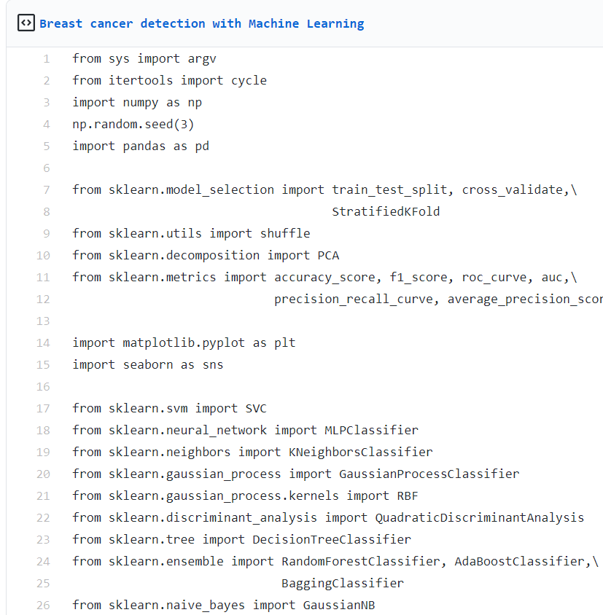
Code Snippets

Slide 16
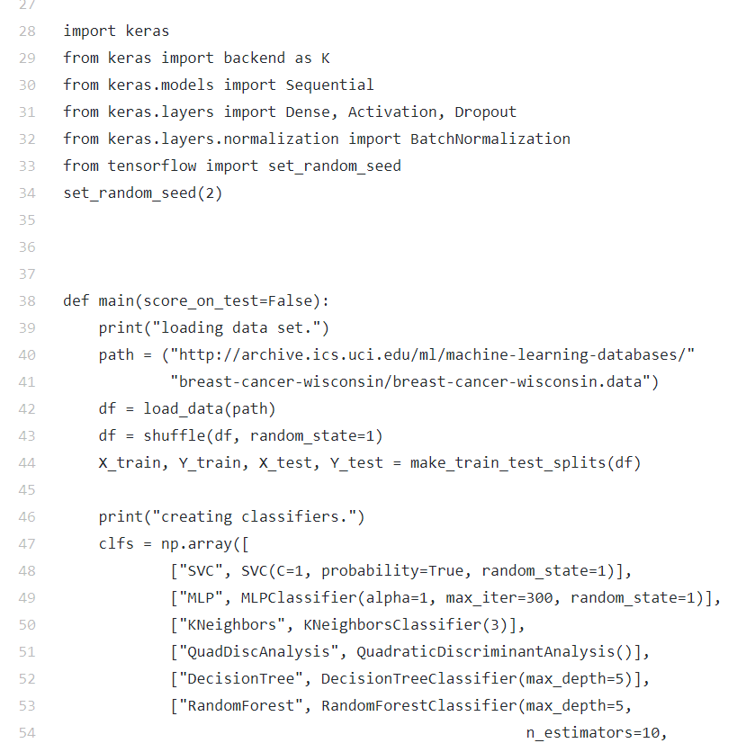
Code Snippets

Slide 17
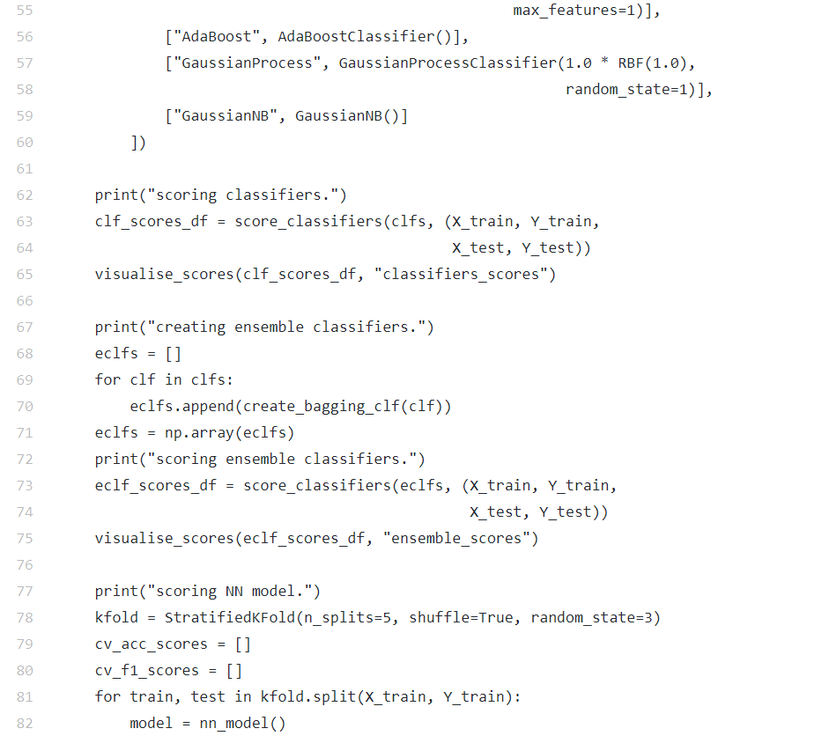
Code Snippets

Slide 18
Potential challenges
Development costs
Integration issues
Ethical issues
Reluctance among medical practitioners to adopt AI
Fear of replacing humans
Data Privacy and security
Mobile health applications and devices that use AI
Lack of interoperability between AI solutions
Data exchange
Need for continuous training by data from clinical studies
Incentives for sharing data on the system for further development and improvement of the system. Nevertheless,
All the parties in the healthcare system, the physicians, the pharmaceutical companies and the patients, have greater incentives to compile and exchange information
State and federal regulations
Rapid and iterative process of software updates commonly used to improve existing products and services

Slide 19
Wrap
These models have shown excellent results on Breast Cancer Wisconsin (Diagnostic) Data Set, however, in order to trust the models, we need to further test them with new data and make sure they are still leading to excellent results
One possible weakness associated with these models is that they do not include any demography, race and genetic sequences attributes and other useful information that could potentially strengthen the ground for classification

Slide 20
Thank you !

